Slide 1



Data Informed Decisions
Summer 2020 Workshop: Taskstream Series #8
presented by: Mary Elizabeth Spence
July 15, 2020
AState.edu
/ArkansasState
@ArkansasState

Slide 2



Workshop Procedures
Welcome and thank you for participating in our Summer Workshop Series!
You will be muted upon entry to the workshop, so please introduce yourself via the Chat feature by clicking “Chat.”
The window to the right will appear where you can add your introduction:
If you have questions during the session, please add them to the Chat box and at the conclusion of our time we will include them in the Q and A.
AState.edu
/ArkansasState
@ArkansasState

Slide 3
Workshop Agenda
Attendees will be able to:
How to report data accurately and clearly
  Summary of Findings that includes frequency/demographic information of students (number of students, level, etc.), date/semester of measure, item/rubric analysis, etc.
  Sampling Methodology if applicable
  Include all raw substantiating evidence
Peer Review Assessment Findings Rubric
AState.edu
/ArkansasState
@ArkansasState

Slide 4
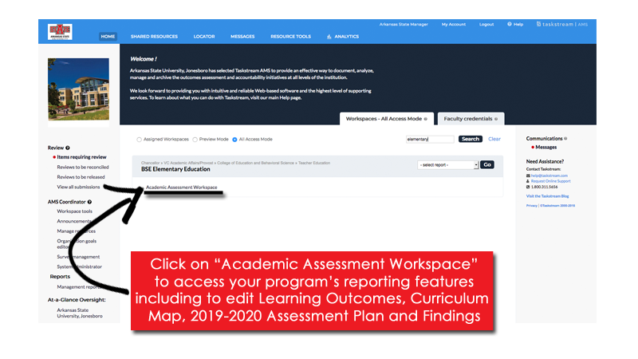

Taskstream Welcome Screen
This screen will show any Programs that you have access to view/edit.
AState.edu
/ArkansasState
@ArkansasState

Slide 5
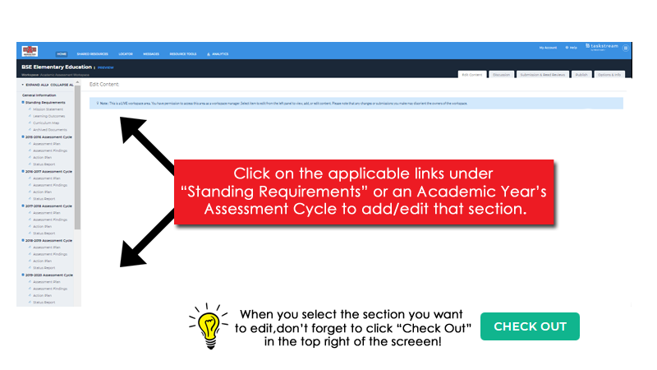
Workspace Landing Screen
This is the initial screen you will see when you select a Workspace.
AState.edu
/ArkansasState
@ArkansasState

Slide 6
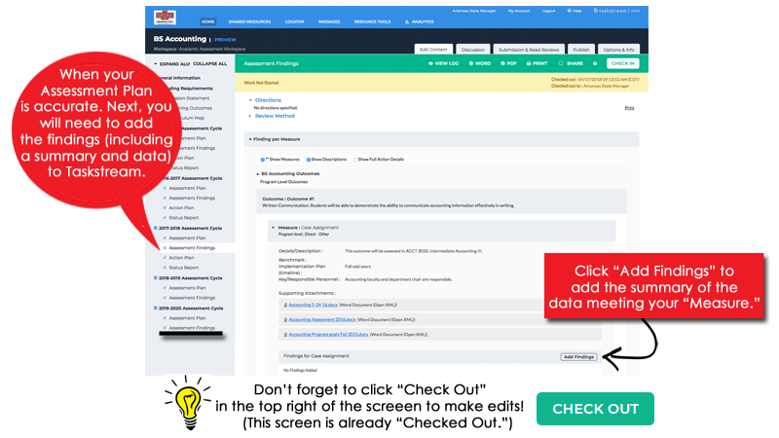
Assessment Findings
AState.edu
/ArkansasState
@ArkansasState

Slide 7
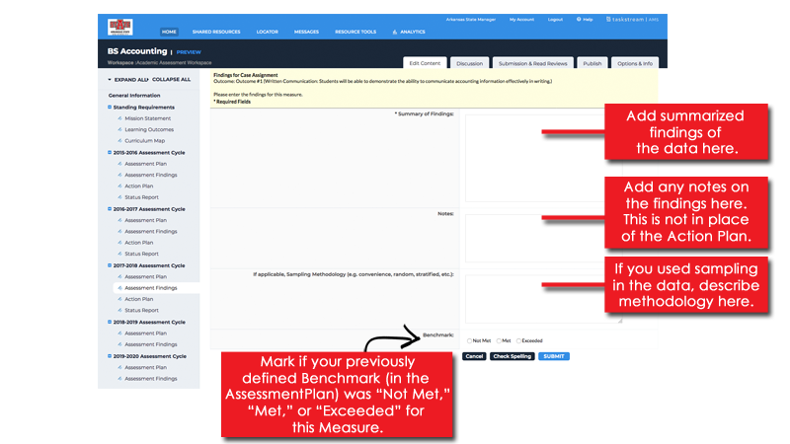
Assessment Findings
After clicking “Add Findings,” the following screen will appear.
AState.edu
/ArkansasState
@ArkansasState

Slide 8
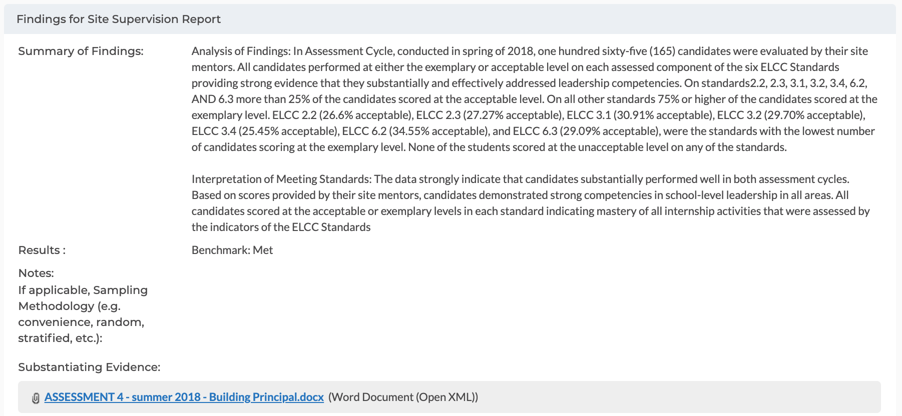
Findings Reporting Examples
AState.edu
/ArkansasState
@ArkansasState

Slide 9
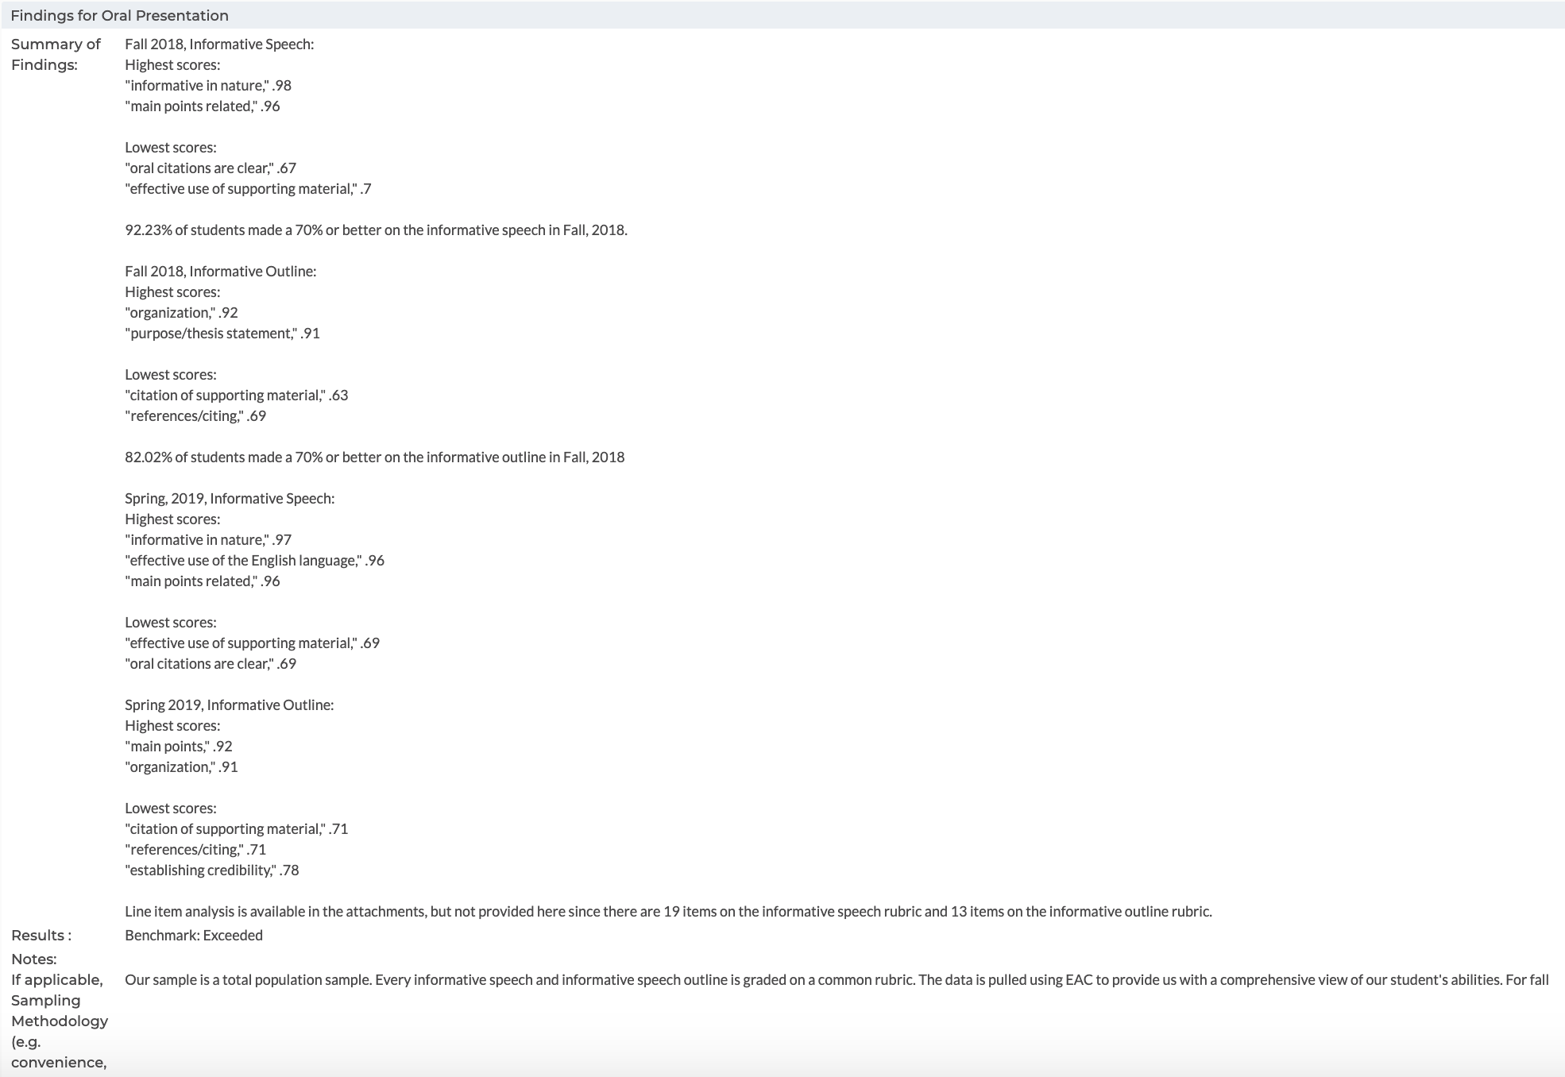
Findings Reporting Examples
AState.edu
/ArkansasState
@ArkansasState

Slide 10
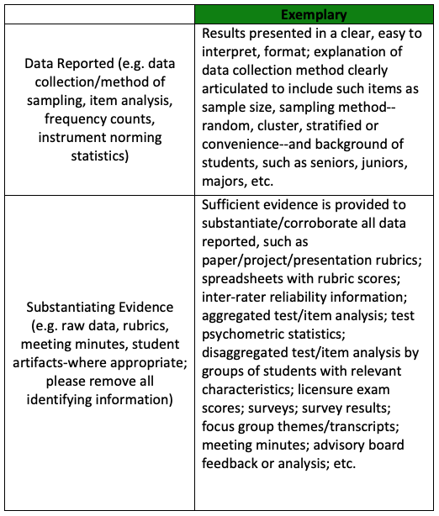
Assessment Findings Reporting Tips
Data Reporting and presenting Substantiating Evidence
-For best practice, summarize the data collected in a way that is clear and aligns directly to the measure and outcome it represents. Ideally the evidence that this summary is created from will be attached in detailed form from rubric rows, exam scores, survey results, etc.
-Please refer to the graphic below for “Exemplary” assessment findings reporting suggestions (For the Peer Review rubric in totality, please see attachment to this email.):
AState.edu
/ArkansasState
@ArkansasState

Slide 11
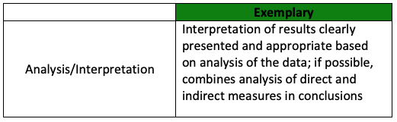
Assessment Findings Reporting Tips
Analysis and Interpretation
-Remember: in order to “connect the dots” between a “good” plan and data that supports that plan, a clearly defined Benchmark must be made in the plan and before it can be “met,” “not met” or exceeded in the summarized findings.
-Please refer to the graphic below for “Exemplary” assessment findings reporting suggestions (For the Peer Review rubric in totality, please see attachment to this email.):
AState.edu
/ArkansasState
@ArkansasState

Slide 12

Session Q & A
AState.edu
/ArkansasState
@ArkansasState

Slide 13

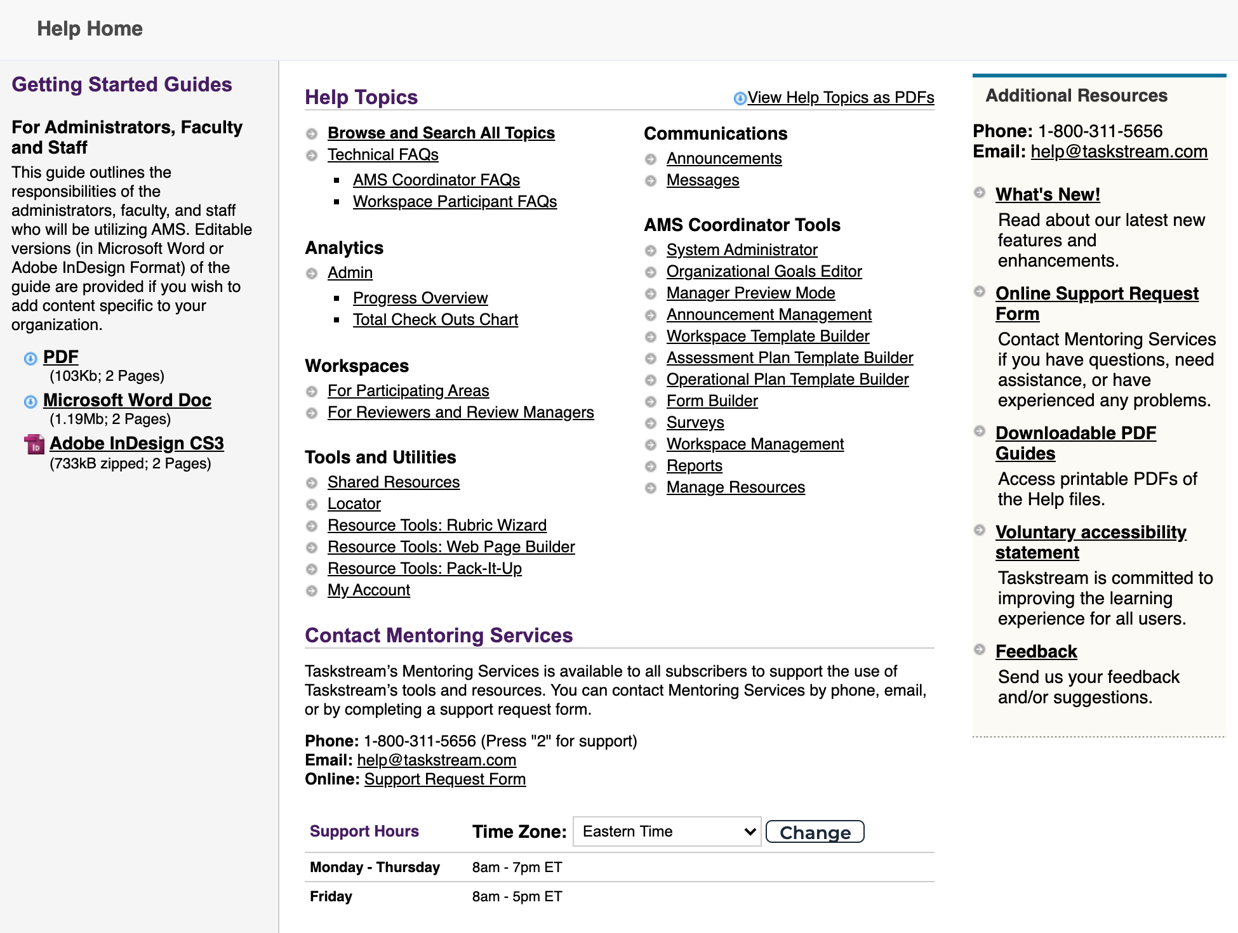
Taskstream Help
For “after hours” assistance, Taskstream has a number of great resources including contact by email and phone and a substantial set of guides. All can be accessed by clicking “? Help”:
AState.edu
/ArkansasState
@ArkansasState

